Slide 1
Bayesian Statistics
Made Simple
Allen B. Downey
Olin College

Slide 2
Follow along at home
sites.google.com/site/simplebayes

Slide 3
The plan
From Bayes's Theorem to Bayesian inference.
A computational framework.
Work on example problems.

Slide 4
Goals
At 4:20, you should be ready to:
Work on similar problems.
Learn more on your own.

Slide 5
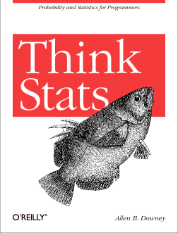
Think Stats
This tutorial is based on my book,
Think Stats: Probability and
Statistics for Programmers.
Published by O'Reilly Media
and available under a
Creative Commons license from
thinkstats.com

Slide 6
Think Bayes
Also based on my new project,
Think Bayes: Bayesian Statistics Made Simple
Current draft available from
thinkbayes.com

Slide 7
Prerequisites
Conditional probability
p(A): the probability that A occurs.
p(A|B): the probability that A occurs, given that B has occurred.
Conjoint probability
p(A and B) = p(A) p(B|A)

Slide 8
Bayes's Theorem
By definition of conjoint probability:
p(A and B) = p(A) p(B|A) = (1)
p(B and A) = p(B) p(A|B)
Equate the right hand sides
p(B) p(A|B) = p(A) p(B|A) (2)
Divide by p(B) and ...

Slide 9
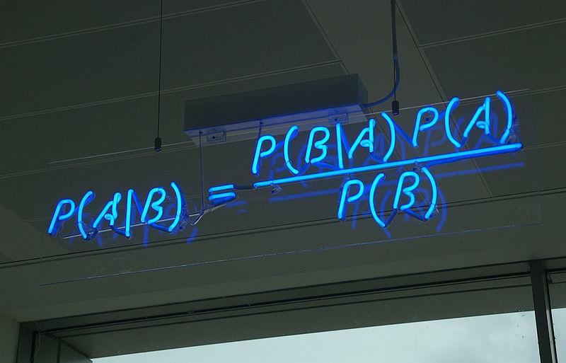
Bayes' Theorem

Slide 10
Bayes's Theorem
One way to think about BT:
Bayes's Theorem is an algorithm to get from p(B|A) to p(A|B).
Useful if p(B|A), p(A) and p(B) are easier than p(A|B).
OR ...

Slide 11
Diachronic interpretation
H: Hypothesis
D: Data
Given p(H), the probability of the hypothesis before you saw the data.
Find p(H|D), the probability of the hypothesis after you saw the data.

Slide 12
A cookie problem
from Wikipedia
Suppose there are two bowls of cookies.
Bowl #1 has 10 chocolate and 30 vanilla.
Bowl #2 has 20 of each.
Fred picks a bowl at random, and then picks a cookie at random. The cookie turns out to be vanilla.
What is the probability that Fred picked from Bowl #1?

Slide 13
Cookie problem
H: Hypothesis that cookie came from Bowl 1.
D: Cookie is vanilla.
Given p(H), the probability of the hypothesis before you saw the data.
Find p(H|D), the probability of the hypothesis after you saw the data.

Slide 14
Diachronic interpretation
p(H|D) = p(H) p(D|H) / p(D)
p(H): prior
p(D|H): conditional likelihood of the data
p(D): total likelihood of the data

Slide 15
Diachronic interpretation
p(H|D) = p(H) p(D|H) / p(D)
p(H): prior = 1/2
p(D|H): conditional likelihood of the data = 3/4
p(D): total likelihood of the data = 5/8

Slide 16
Diachronic interpretation
p(H|D) = (1/2)(3/4) / (5/8) = 3/5
p(H): prior = 1/2
p(D|H): conditional likelihood of the data = 3/4
p(D): total likelihood of the data = 5/8

Slide 17
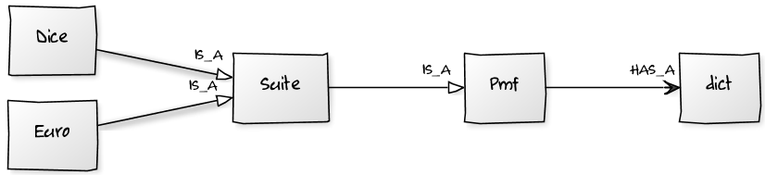
Computation
Pmf represents a Probability Mass Function
Maps from possible values to probabilities.
Diagram by yuml.me

Slide 18
Install test
How many of you got install_test.py running?
Don't try to fix it now!
Instead...

Slide 19
Partner up
If you don't have a working environment, find a neighbor who does.
Even if you do, try pair programming!
Take a minute to introduce yourself.
Questions? Ask your partner first (please).

Slide 20
Icebreaker
What was your first computer?
What was your first programming language?
What is the longest time you have spent finding a stupid bug?

Slide 21
Start your engines
You downloaded bayes_pycon13.zip, right?
cd into that directory (or set PYTHON_PATH)
Start the Python interpreter.
>>> from thinkbayes import Pmf

Slide 22
Pmf
from thinkbayes import Pmf
# make an empty Pmf
pmf = Pmf()
# outcomes of a six-sided die
for x in [1,2,3,4,5,6]:
pmf.Set(x, 1)

Slide 23
Pmf
pmf.Print()
pmf.Normalize()
pmf.Print()

Slide 24

Style
I know what you're thinking.

Slide 25
The framework
1) Build a Pmf that maps from each hypothesis to a prior probability, p(H).
2) Multiply each prior probability by the likelihood of the data, p(D|H).
3) Normalize, which divides through by the total likelihood, p(D).

Slide 26
Prior
pmf = Pmf()
pmf.Set('Bowl 1', 0.5)
pmf.Set('Bowl 2', 0.5)

Slide 27
Update
p(Vanilla | Bowl 1) = 30/40
p(Vanilla | Bowl 2) = 20/40
pmf.Mult('Bowl 1', 0.75)
pmf.Mult('Bowl 2', 0.5)

Slide 28
Normalize
pmf.Normalize()
print pmf.Prob('Bowl 1')

Slide 29

Summary
Bayes's Theorem,
Cookie problem,
Pmf class.

Slide 30
The dice problem
I have a box of dice that contains a 4-sided die, a 6-sided die, an 8-sided die, a 12-sided die and a 20-sided die.
Suppose I select a die from the box at random, roll it, and get a 6. What is the probability that I rolled each die?

Slide 31
Hypothesis suites
A suite is a mutually exclusive and collectively exhaustive set of hypotheses.
Represented by a Suite that maps
hypothesis → probability.

Slide 32
Suite
class Suite(Pmf):
"Represents a suite of hypotheses and
their probabilities."
def __init__(self, hypos):
"Initializes the distribution."
for hypo in hypos:
self.Set(hypo, 1)
self.Normalize()

Slide 33
Dice
from thinkbayes import Suite
# start with equal priors
suite = Suite([4, 6, 8, 12, 20])
suite.Print()

Slide 34
Suite
def Update(self, data):
"Updates the suite based on data."
for hypo in self.Values(): like = self.Likelihood(hypo, data) self.Mult(hypo, like)
self.Normalize()
self.Likelihood?

Slide 35
Suite
Likelihood is an abstract method.
Child classes inherit Update,
provide Likelihood.

Slide 36
Likelihood
Outcome: 6
What is the likelihood of this outcome on a six-sided die?
On a ten-sided die?
On a four-sided die?
What is the likelihood of getting n on an m-sided die?

Slide 37
Likelihood
# hypo is the number of sides on the die
# data is the outcome
class Dice(Suite):
def Likelihood(self, hypo, data): # write this method!
Write your solution in dice.py

Slide 38
Likelihood
# hypo is the number of sides on the die
# data is the outcome
class Dice(Suite):
def Likelihood(self, hypo, data): if hypo < data: return 0 else: return 1.0/hypo

Slide 39
Dice
# start with equal priors
suite = Dice([4, 6, 8, 12, 20])
# update with the data
suite.Update(6)
suite.Print()

Slide 40
Dice
Posterior distribution:
4 0.0
6 0.39
8 0.30
12 0.19
20 0.12
More data? No problem...

Slide 41
Dice
for roll in [6, 4, 8, 7, 7, 2]:
suite.Update(roll)
suite.Print()

Slide 42
Dice
Posterior distribution:
4 0.0
6 0.0
8 0.92
12 0.080
20 0.0038

Slide 43
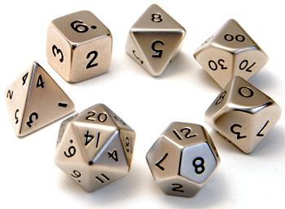
Summary
Dice problem,
Likelihood function,
Suite class.

Slide 44

Recess!
http://ksdcitizens.org/wp-content/uploads/2010/09/recess_time.jpg

Slide 45
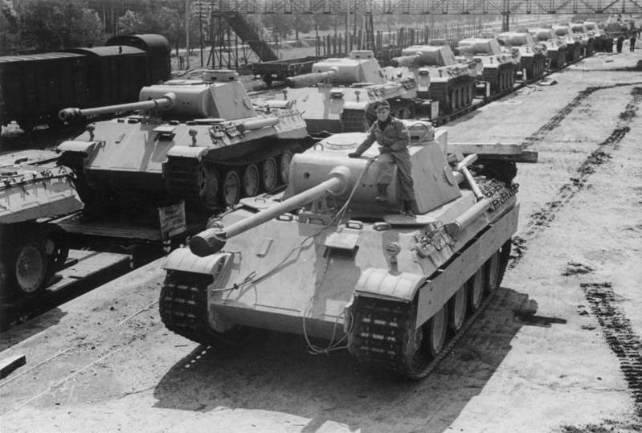
Tanks
The German tank problem.
http://en.wikipedia.org/wiki/German_tank_problem

Slide 46
Trains
The trainspotting problem:
You believe that a freight carrier operates between 100 and 1000 locomotives with consecutive serial numbers.
You spot locomotive #321.
How many trains does the carrier operate?
Modify train.py to compute your answer.

Slide 47
Trains
If there are m trains, what is the chance of spotting train #n?
What does the posterior distribution look like?
What if we spot more trains?
Why did we do this example?

Slide 48
A Euro problem
"When spun on edge 250 times, a Belgian one-euro coin came up heads 140 times and tails 110. 'It looks very suspicious to me,' said Barry Blight, a statistics lecturer at the London School of Economics. 'If the coin were unbiased, the chance of getting a result as extreme as that would be less than 7%.' "
From "The Guardian" quoted by MacKay, Information Theory, Inference, and Learning Algorithms.

Slide 49
A Euro problem
MacKay asks, "But do these data give evidence that the coin is biased rather than fair?"
Assume that the coin has probability x of landing heads.
(Forget that x is a probability; just think of it as a physical characteristic.)

Slide 50
A Euro problem
Estimation: Based on the data (140 heads, 110 tails), what is x?
Hypothesis testing: What is the probability that the coin is fair?

Slide 51
Euro
We can use the Suite template again.
We just have to figure out the likelihood function.

Slide 52
Likelihood
# hypo is the prob of heads (1-100)
# data is a string, either 'H' or 'T'
class Euro(Suite): def Likelihood(self, hypo, data): # one more, please!
Modify euro.py to compute your answer.

Slide 53
Likelihood
# hypo is the prob of heads (1-100)
# data is a string, either 'H' or 'T'
class Euro(Suite): def Likelihood(self, hypo, data): x = hypo / 100.0 if data == 'H': return x else: return 1-x

Slide 54
Prior
Start with something simple; we'll come back and review.
Uniform prior: any value of x between 0% and 100% is equally likely.

Slide 55
Prior
suite = Euro(range(0, 101))

Slide 56
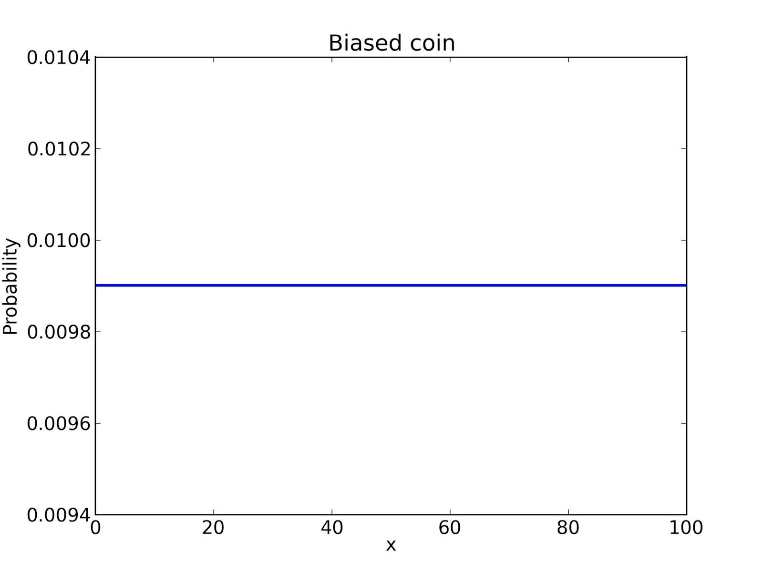

Slide 57
Update
Suppose we spin the coin once and get heads.
suite.Update('H')
What does the posterior distribution look like?
Hint: what is p(x=0% | D)?

Slide 58
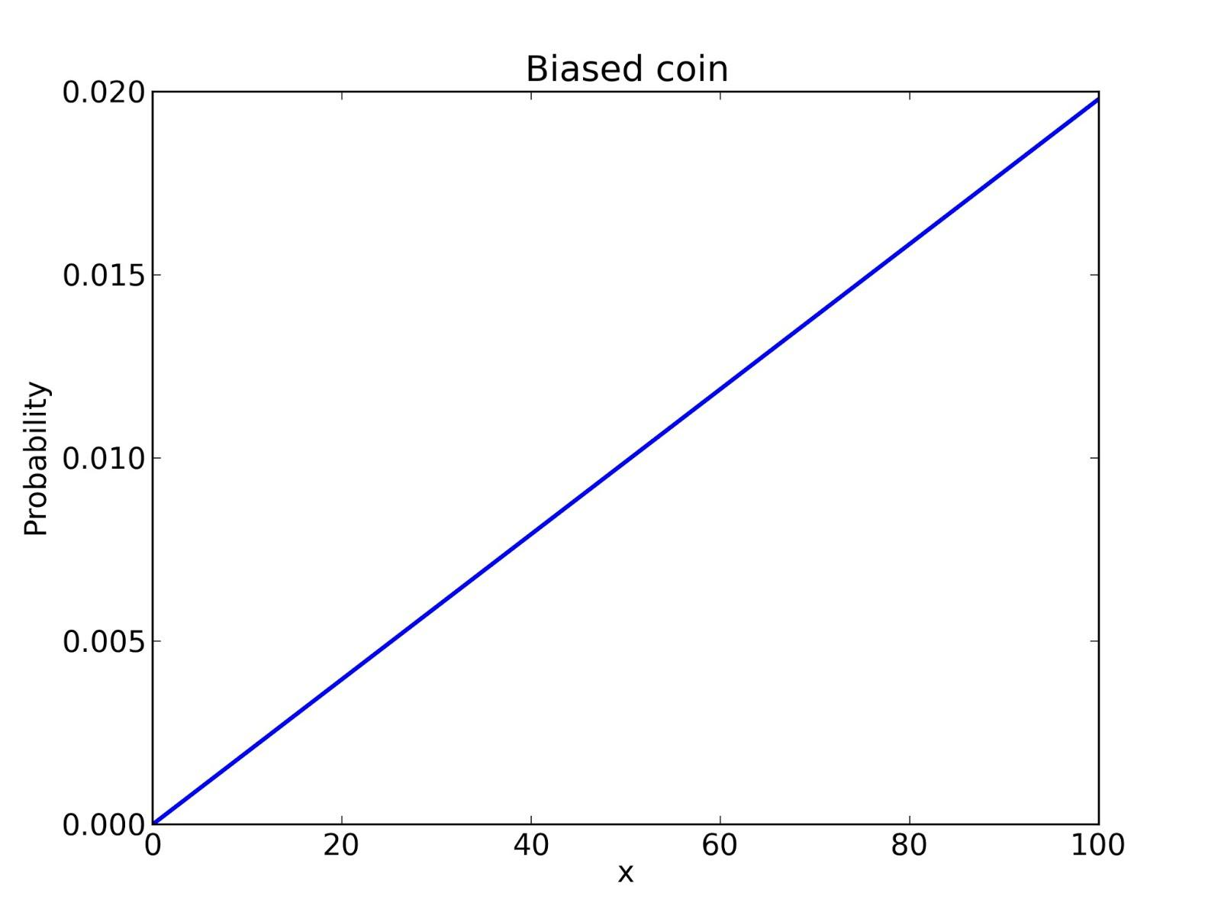

Slide 59
Update
Suppose we spin the coin again, and get heads again.
suite.Update('H')
What does the posterior distribution look like?

Slide 60
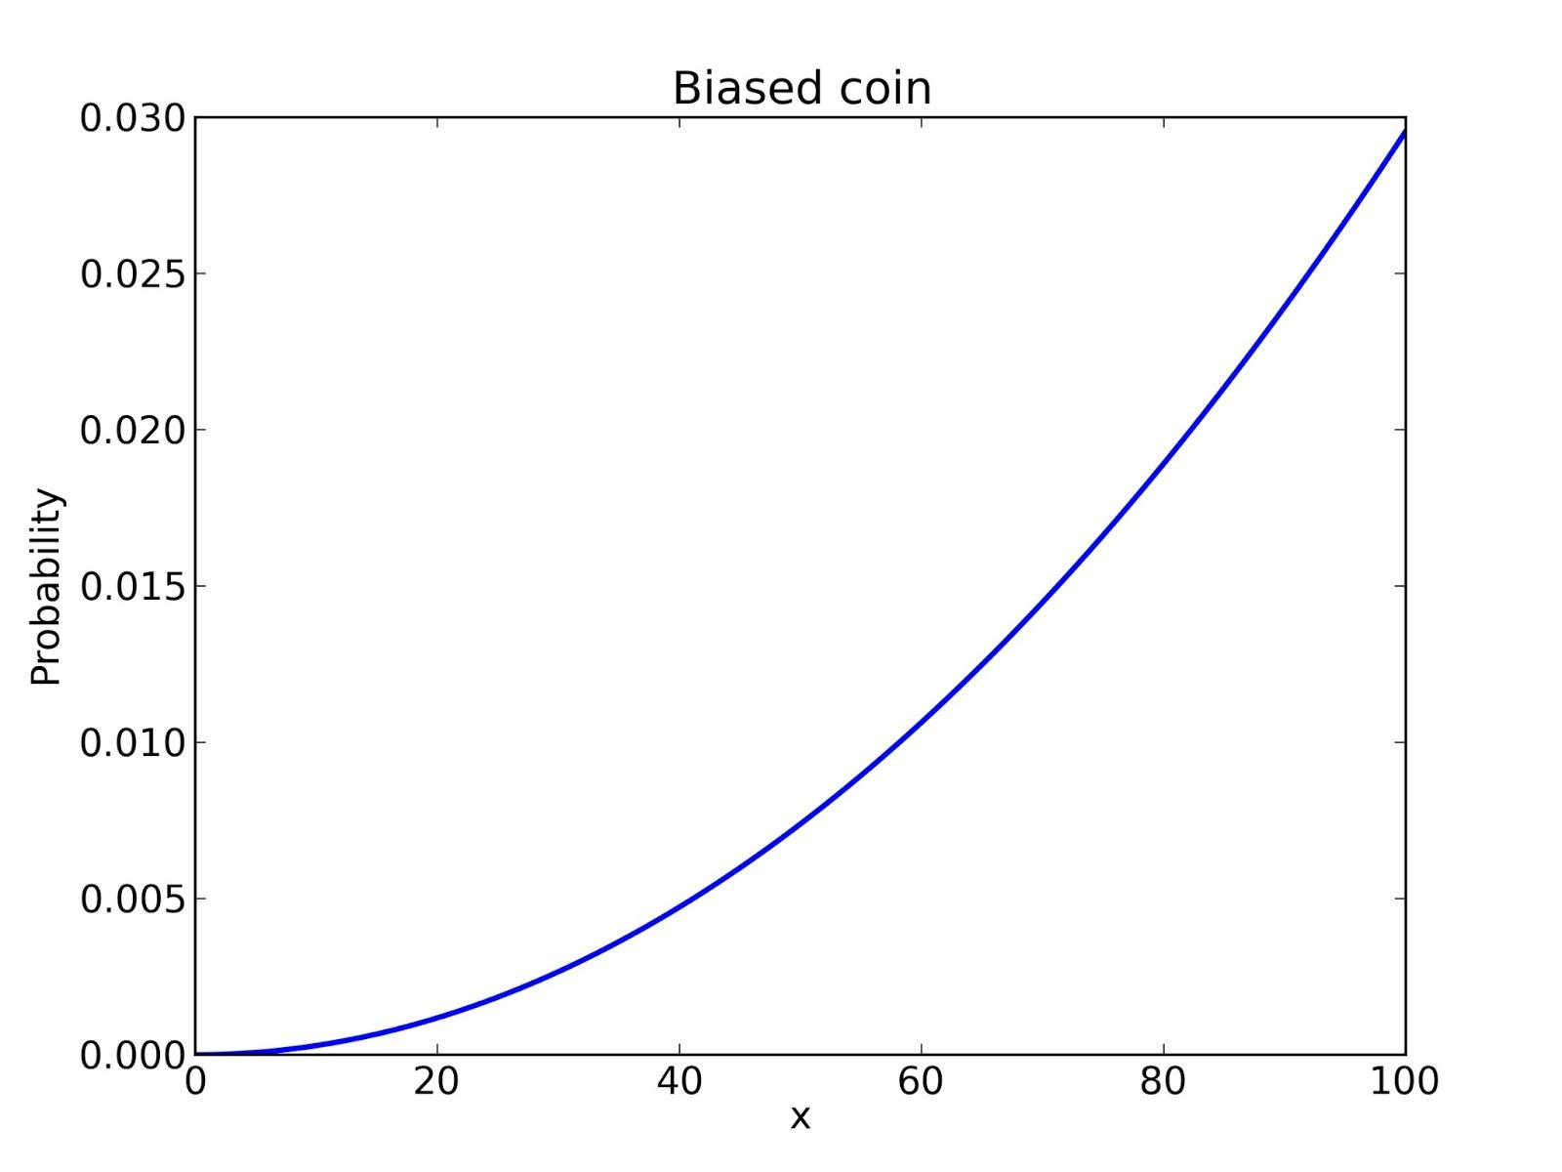

Slide 61
Update
Suppose we spin the coin again, and get tails.
suite.Update('T')
What does the posterior distribution look like?
Hint: what's p(x=100% | D)?

Slide 62
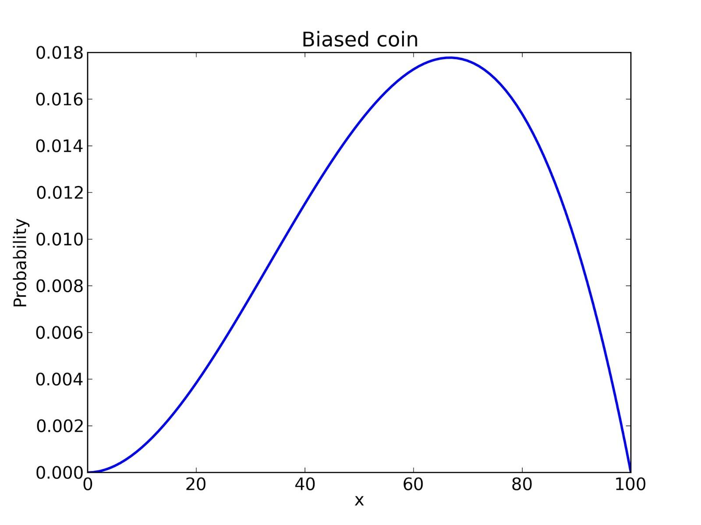

Slide 63
Update
After 10 spins, 7 heads and 3 tails:
for outcome in 'HHHHHHHTTT':
suite.Update(outcome)

Slide 64
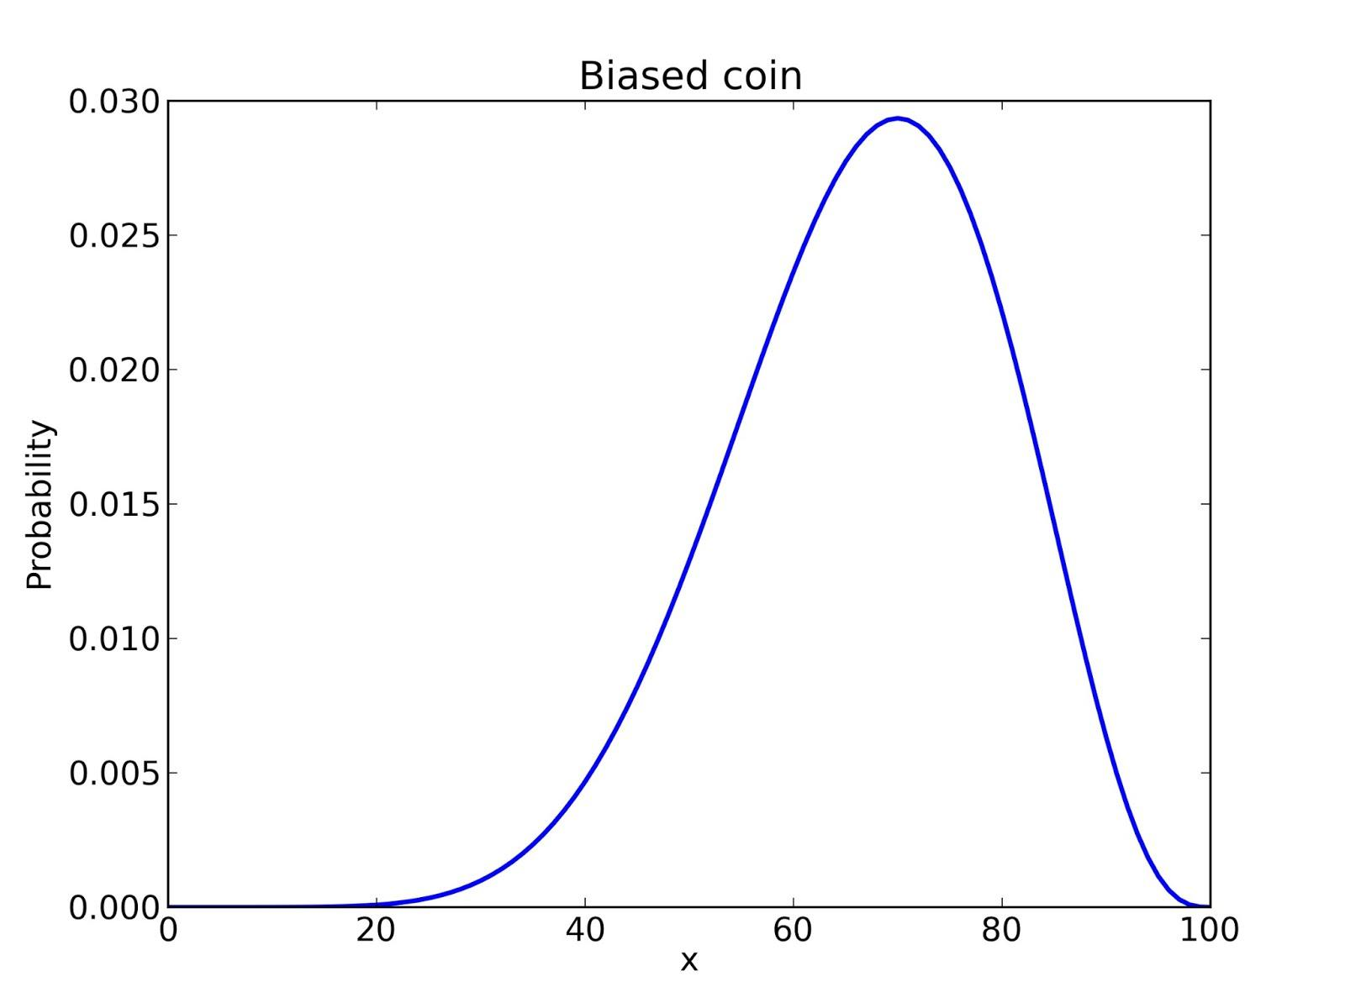

Slide 65
Update
And finally, after 140 heads and 110 tails:
evidence = 'H' * 140 + 'T' * 110
for outcome in evidence:
suite.Update(outcome)

Slide 66
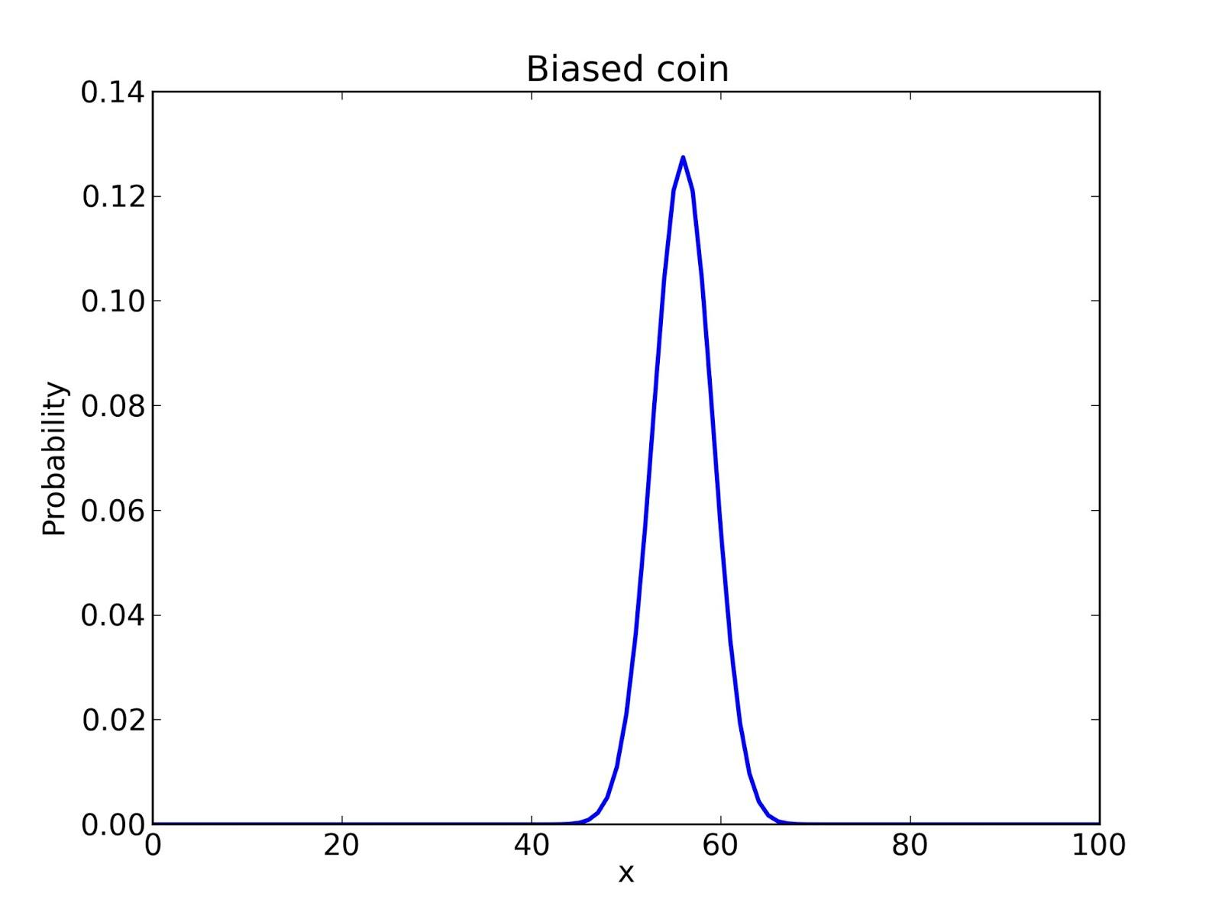

Slide 67
Posterior
Now what?
How do we summarize the information in the posterior PMF?

Slide 68
Posterior
Given the posterior distribution, what is the probability that x is 50%?
print pmf.Prob(50)
And the answer is... 0.021
Hmm. Maybe that's not the right question.

Slide 69
Posterior
How about the most likely value of x?
def MLE(pmf):
prob, val = max((prob, val)
for val, prob in
pmf.Items())
return val
And the answer is 56%.

Slide 70
Posterior
Or the expected value?
def Mean(pmf):
total = 0
for val, prob in pmf.Items():
total += val * prob
return total
And the answer is 55.95%.

Slide 71
Posterior
The 5th percentile is 51.
def Percentile(pmf, p):
total = 0
for val, prob in sorted(pmf.Items()):
total += prob
if total >= p:
return val

Slide 72
Posterior
The 5th percentile is 51.
The 95th percentile is 61.
These values form a 90% credible interval.
So can we say: "There's a 90% chance that x is between 51 and 61?"

Slide 73
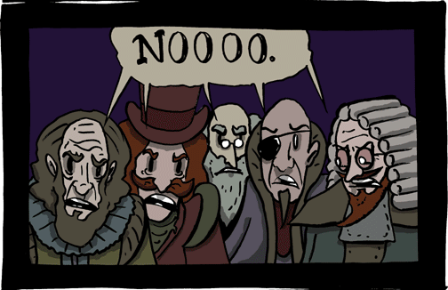
Frequentist response
Thank you smbc-comics.com

Slide 74
Bayesian response
Yes, x is a random variable,
Yes, (51, 61) is a 90% credible interval,
Yes, x has a 90% chance of being in it.
However...

Slide 75
The prior is subjective
Remember the prior?
We chose it pretty arbitrarily, and reasonable people might disagree.
Is x as likely to be 1% as 50%?
Given what we know about coins, I doubt it.

Slide 76
Prior
How should we capture background knowledge about coins?
Try a triangle prior.

Slide 77
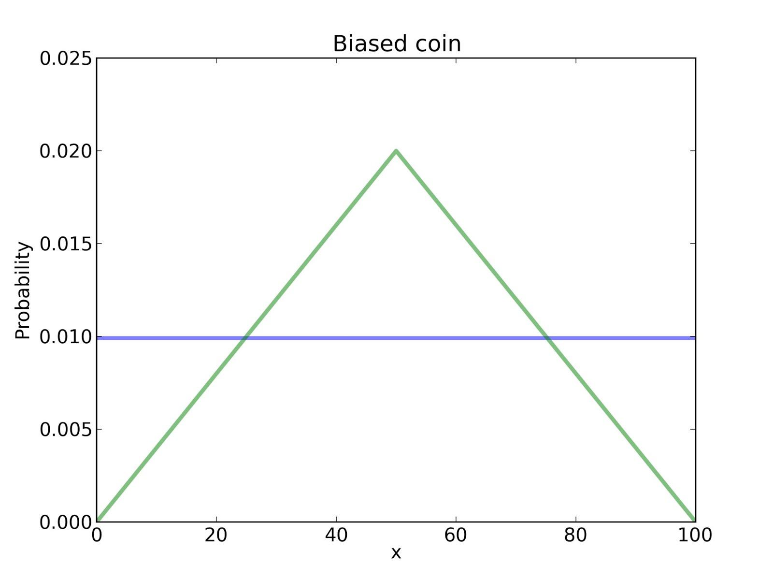

Slide 78
Posterior
What do you think the posterior distribution looks like?
I was going to put an image here, but then I Googled "posterior". Never mind.

Slide 79
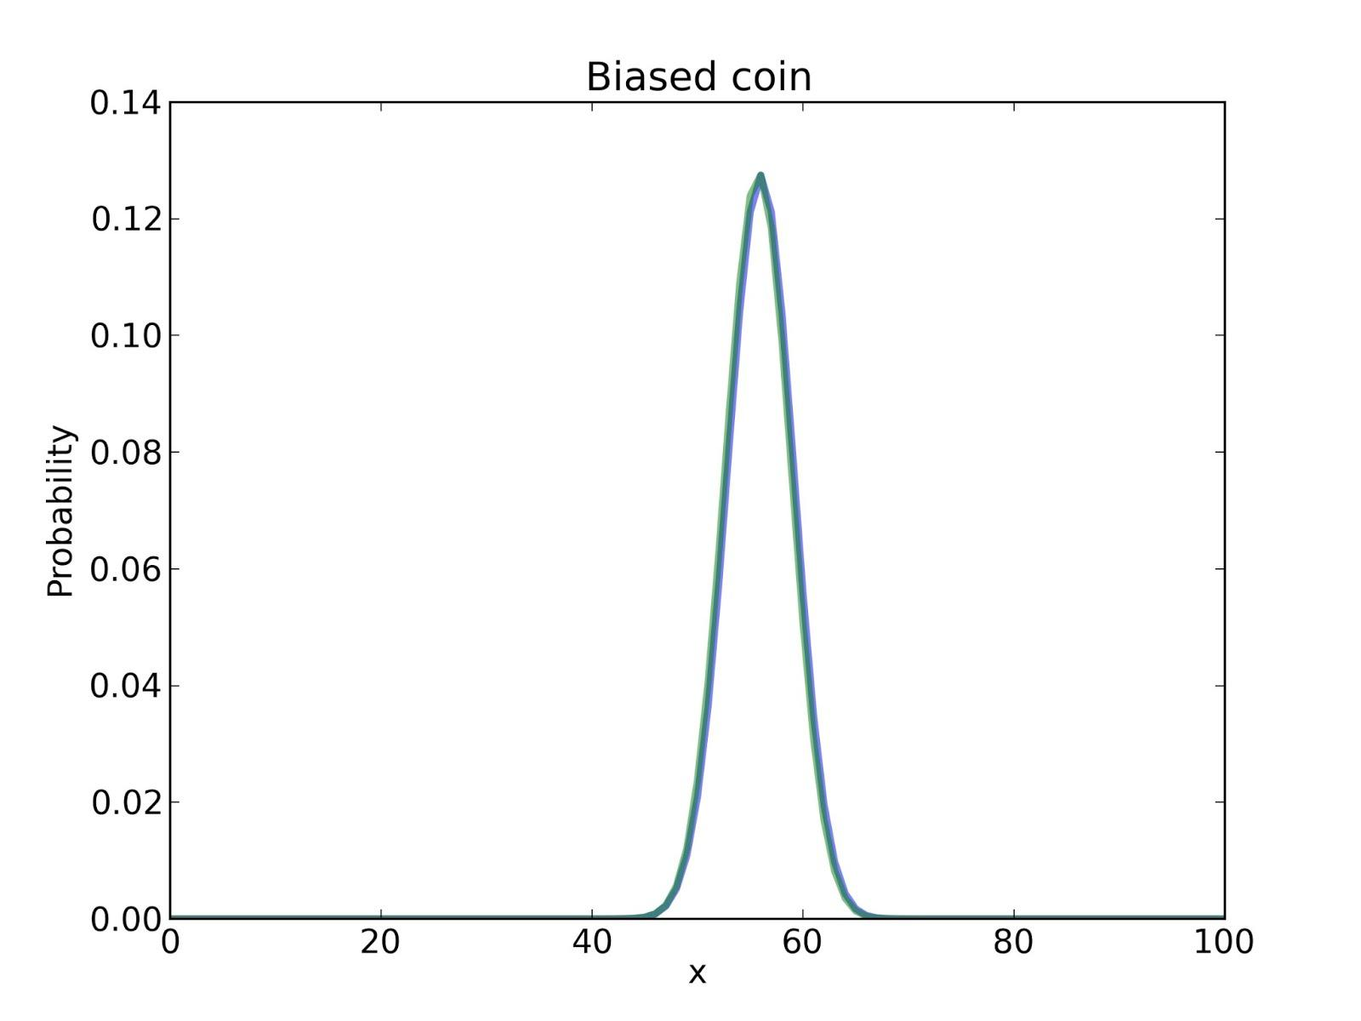

Slide 80
Swamp the prior
With enough data, reasonable people converge.
But if any p(H_{i}) = 0, no data will change that.

Slide 81
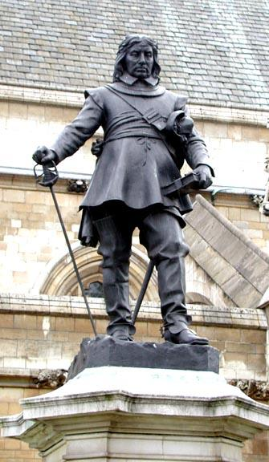
Swamp the prior
Priors can be arbitrarily low, but avoid 0.
See wikipedia.org/wiki/
Cromwell's_rule
"I beseech you, in the bowels of Christ, think it possible that you may be mistaken."

Slide 82
Summary of estimation
Form a suite of hypotheses, H_{i}.
Choose prior distribution, p(H_{i}).
Compute likelihoods, p(D|H_{i}).
Turn off brain.
Compute posteriors, p(H_{i}|D).

Slide 83

Recess!
http://images2.wikia.nocookie.net/__cb20120116013507/recess/images/4/4c/Recess_Pic_for_the_Internet.png

Slide 84
Hypothesis testing
Remember the original question:
"But do these data give evidence that the coin is biased rather than fair?"
What does it mean to say that data give evidence for (or against) a hypothesis?

Slide 85

Hypothesis testing
D is evidence in favor of H if
p(H|D) > p(H)
which is true if
p(D|H) > p(D|~H)
or equivalently if
p(D|H) / p(D|~H) > 1

Slide 86
Hypothesis testing
This term
p(D|H) / p(D|~H)
is called the likelihood ratio, or Bayes factor.
It measures the strength of the evidence.

Slide 87
Hypothesis testing
F: hypothesis that the coin is fair
B: hypothesis that the coin is biased
p(D|F) is easy.
p(D|B) is hard because B is underspecified.

Slide 88
Bogosity
Tempting: we got 140 heads out of 250 spins, so B is the hypothesis that x = 140/250.
But,
Doesn't seem right to use the data twice.
By this process, almost any data would be evidence in favor of B.

Slide 89
We need some rules
You have to choose your hypothesis before you see the data.
You can choose a suite of hypotheses, but in that case we average over the suite.

Slide 90


Slide 91
Likelihood
def AverageLikelihood(suite, data):
total = 0
for hypo, prob in suite.Items():
like = suite.Likelihood(hypo, data)
total += prob * like
return total

Slide 92
Hypothesis testing
F: hypothesis that x = 50%.
B: hypothesis that x is not 50%, but might be any other value with equal probability.

Slide 93

Prior
fair = Euro()
fair.Set(50, 1)

Slide 94

Prior
bias = Euro()
for x in range(0, 101):
if x != 50:
bias.Set(x, 1)
bias.Normalize()

Slide 95
Bayes factor
data = 140, 110
like_fair = AverageLikelihood(fair, data)
like_bias = AverageLikelihood(bias, data)
ratio = like_bias / like_fair

Slide 96
Hypothesis testing
Read euro2.py.
Notice the new Likelihood function.
Run it and interpret the results.

Slide 97
Hypothesis testing
And the answer is:
p(D|B) = 2.6 · 10⁻⁷⁶
p(D|F) = 5.5 · 10⁻⁷⁶
Likelihood ratio is about 0.47.
So this dataset is evidence against B.

Slide 98
Fair comparison?
Modify the code that builds bias; try out a different definition of B and run again.

Slide 99
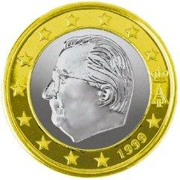
Summary
Euro problem,
Bayesian estimation,
Bayesian hypothesis testing.

Slide 100
Recess!
http://ksdcitizens.org/wp-content/uploads/2010/09/recess_time.jpg

Slide 101
Word problem for geeks
ALICE: What did you get on the math SAT?
BOB: 760
ALICE: Oh, well I got a 780. I guess that means I'm smarter than you.
NARRATOR: Really? What is the probability that Alice is smarter than Bob?

Slide 102
Assume, define, quantify
Assume: each person has some probability, x, of answering a random SAT question correctly.
Define: "Alice is smarter than Bob" means x_{a} > x_{b}.
How can we quantify Prob { x_{a} > x_{b} } ?

Slide 103

Be Bayesian
Treat x as a random quantity.
Start with a prior distribution.
Update it.
Compare posterior distributions.

Slide 104
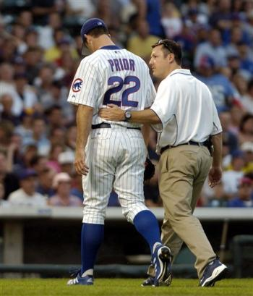
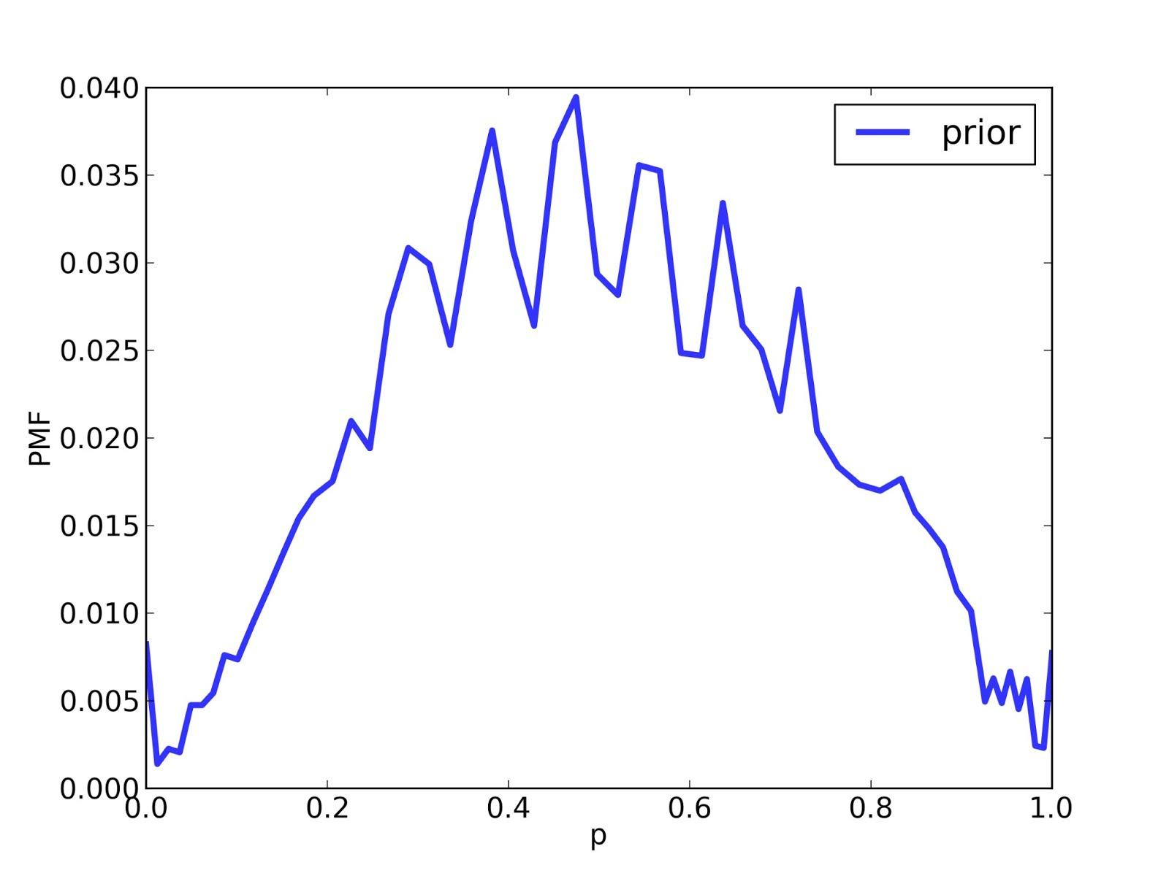
Prior?
Distribution of raw scores.

Slide 105
Likelihood
def Likelihood(data, hypo):
x = hypo score = data raw = self.exam.Reverse(score) yes, no = raw, self.exam.max_score - raw like = x**yes * (1-x)**no return like

Slide 106
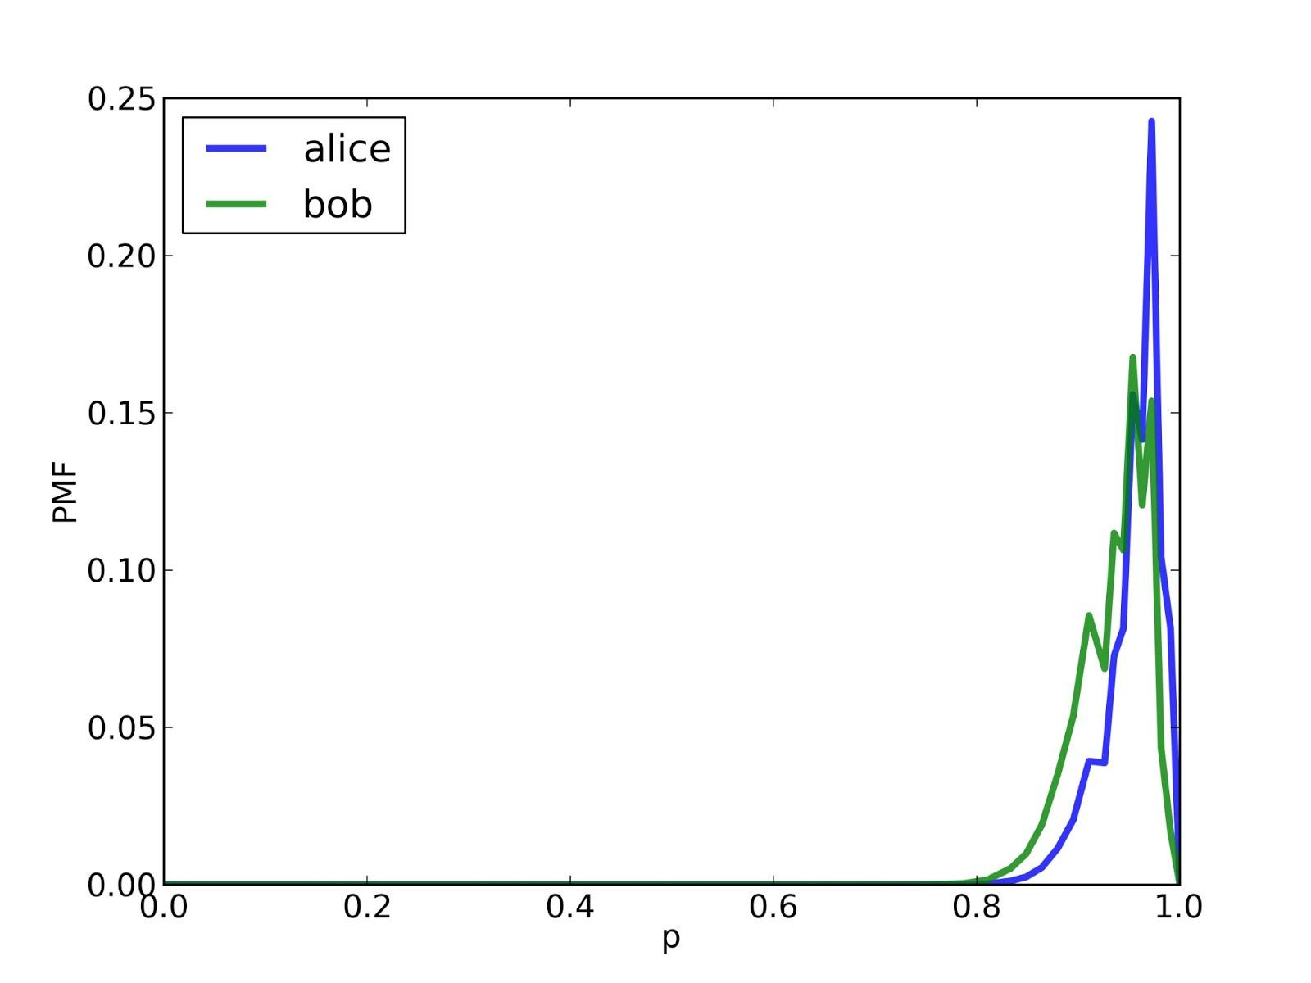
Posterior

Slide 107
ProbBigger
def ProbBigger(pmf1, pmf2):
"""Returns the prob that a value from pmf1
is greater than a value from pmf2."""

Slide 108
ProbBigger
def ProbBigger(pmf1, pmf2):
"""Returns the prob that a value from pmf1
is greater than a value from pmf2."""
Iterate through all pairs of values.
Check whether the value from pmf1 is greater.
Add up total probability of successful pairs.

Slide 109
ProbBigger
def ProbBigger(pmf1, pmf2):
for x1, p1 in pmf1.Items():
for x2, p2 in pmf2.Items():
# FILL THIS IN!

Slide 110
ProbBigger
def ProbBigger(pmf1, pmf2):
total = 0.0
for x1, p1 in pmf1.Items():
for x2, p2 in pmf2.Items():
if x1 > x2:
total += p1 * p2
return total

Slide 111

And the answer is...
Alice: 780
Bob: 760
Probability that Alice is "smarter": 61%

Slide 112
Two points
Posterior distribution is often the input to the next step in an analysis.
Real world problems start (and end!) with modeling.

Slide 113
Modeling
This result is based on the simplification that all SAT questions are equally difficult.
An alternative (in the book) is based on item response theory.

Slide 114
Modeling
For most real world problems, there are several reasonable models.
The best choice depends on your goals.
Modeling errors probably dominate.

Slide 115
Modeling
Therefore:
Don't mistake the map for the territory.
Don't sweat approximations smaller than modeling errors.
Iterate.

Slide 116
Recess!
http://images2.wikia.nocookie.net/__cb20120116013507/recess/images/4/4c/Recess_Pic_for_the_Internet.png

Slide 117

Relax

Slide 118
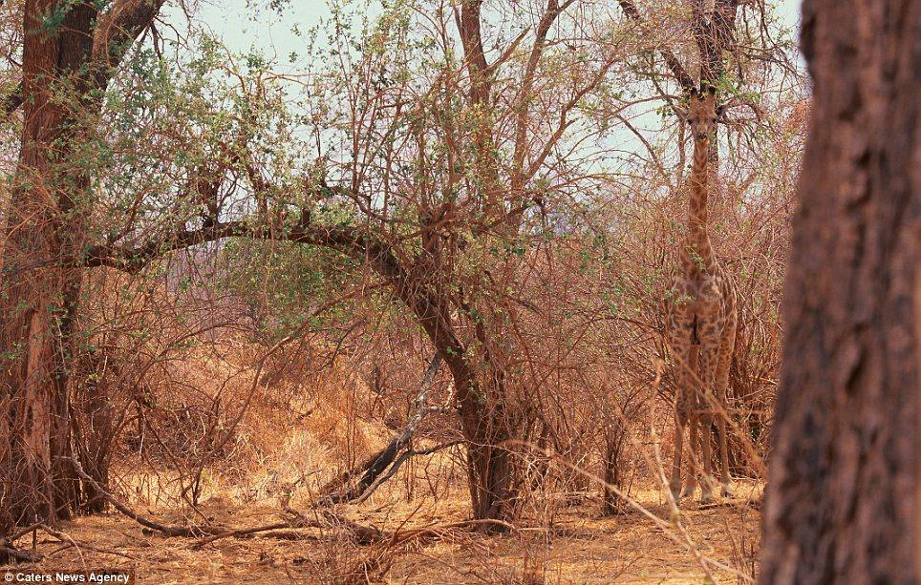
Unseen species problem

Slide 119
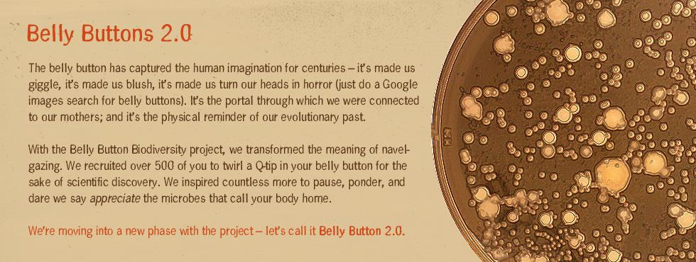
Unseen species problem

Slide 120
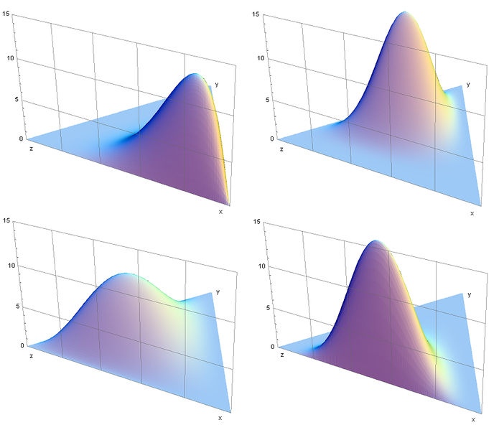
Dirichlet distribution
If we knew the number of species, we could estimate the prevalence of each.

Slide 121
Hierarchical Bayes
For a hypothetical value of n, we can compute the likelihood of the data.
Using Bayes's Theorem, we can get the posterior distribution of n.

Slide 122
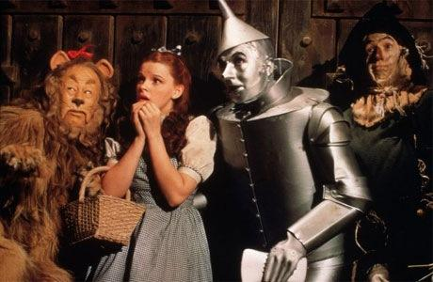
Lions and tigers and bears
Suppose we have seen 3 lions and 2 tigers and 1 bear.
There must be at least 3 species.
And up to 30?

Slide 123
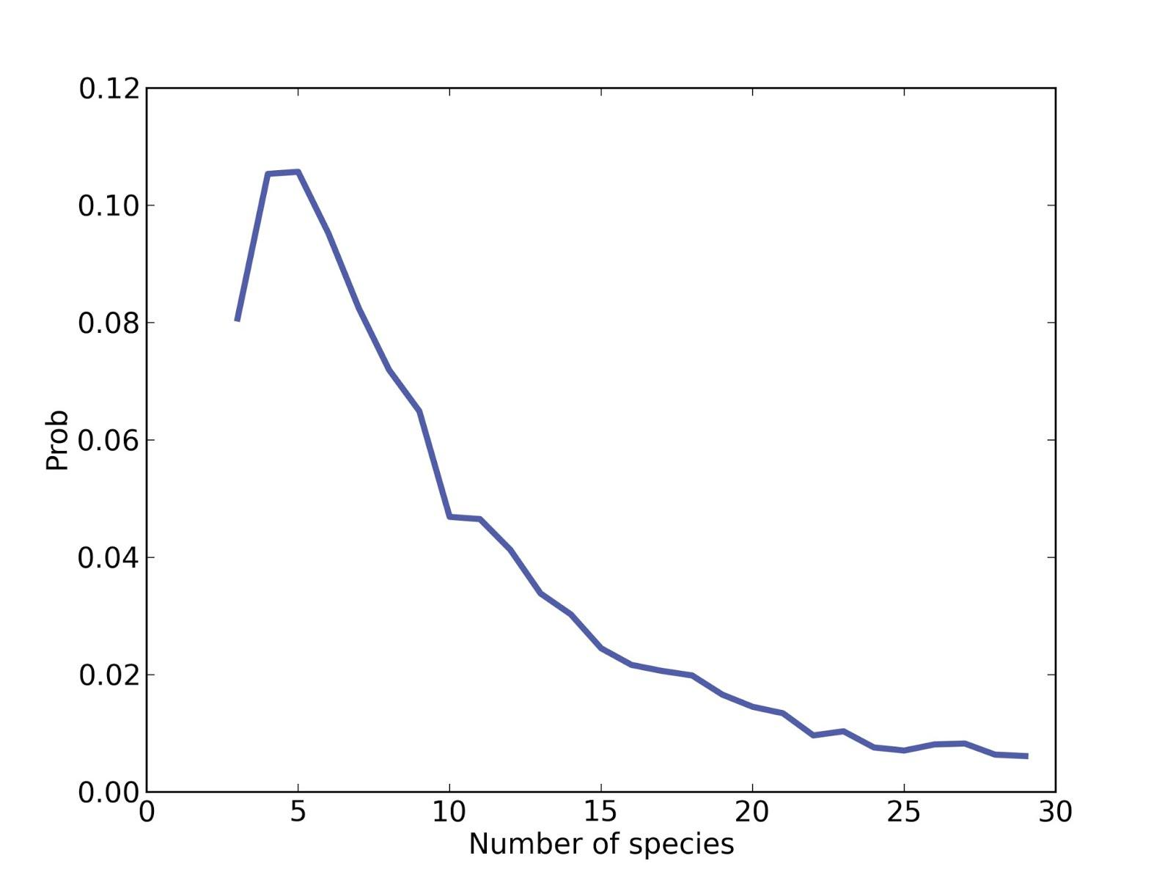
The posterior

Slide 124
B1242
92 Corynebacterium 53 Anaerococcus 47 Finegoldia 38 Staphylococcus 15 Peptoniphilus 14 Anaerococcus 12 unidentified 10 Clostridiales 8 Lactobacillales 7 Corynebacterium
and 1 Partridgeinnapeartrium.

Slide 125
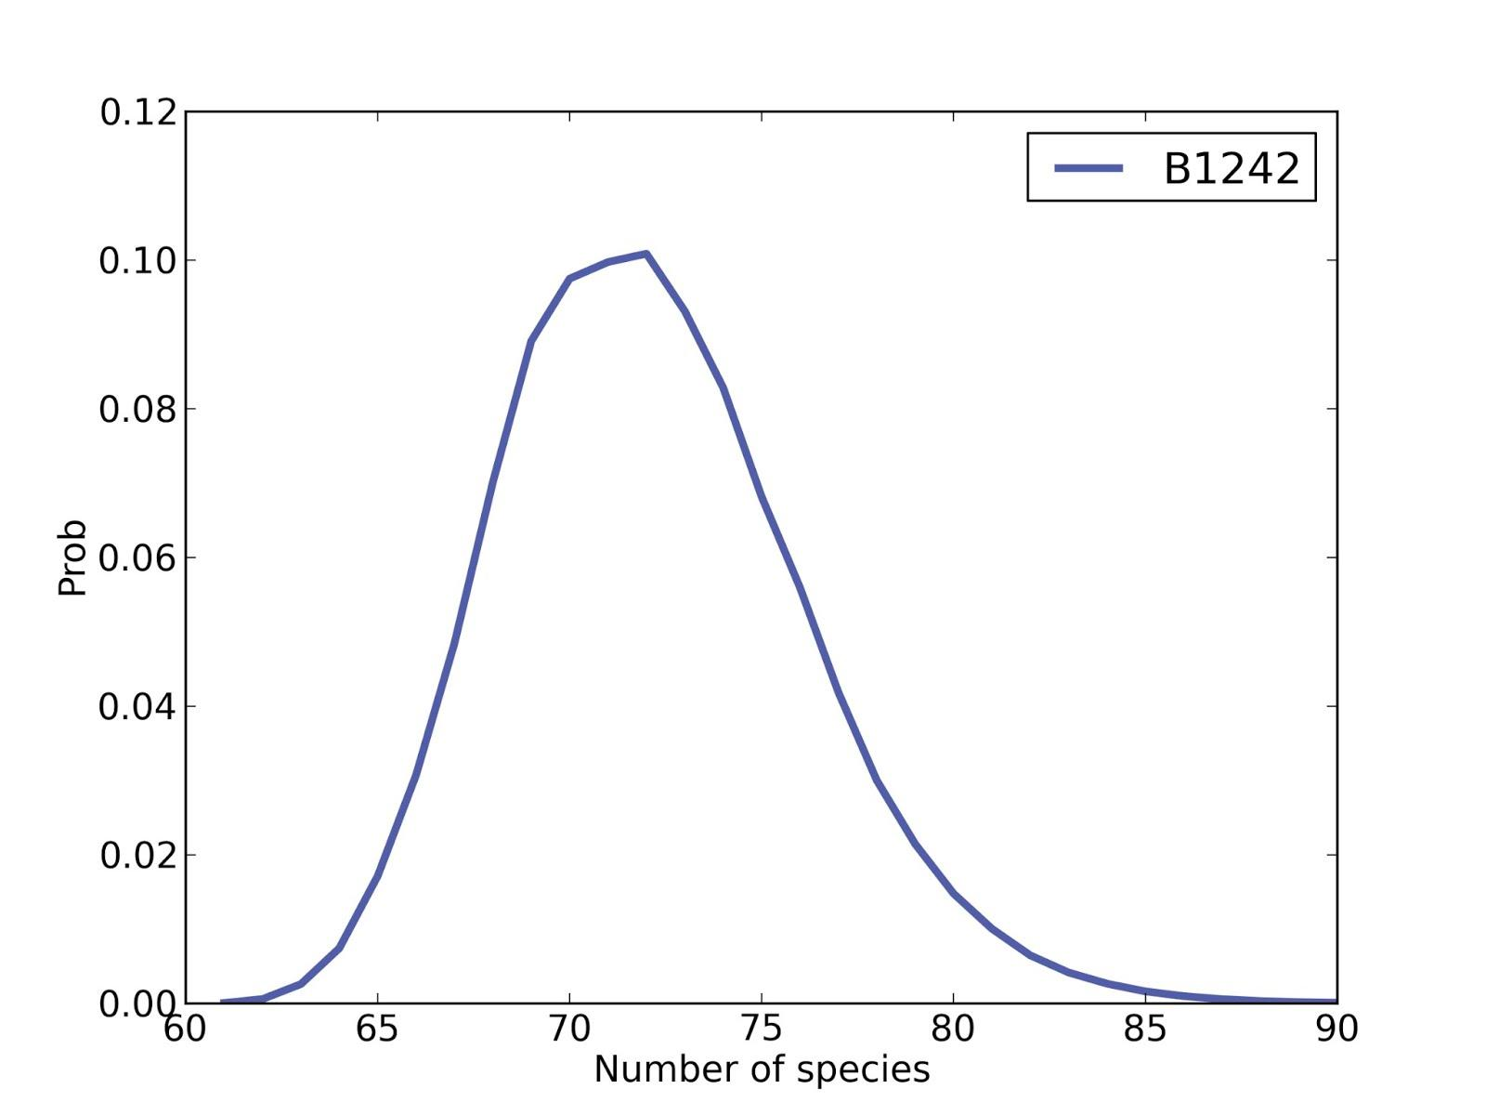
Number of species

Slide 126
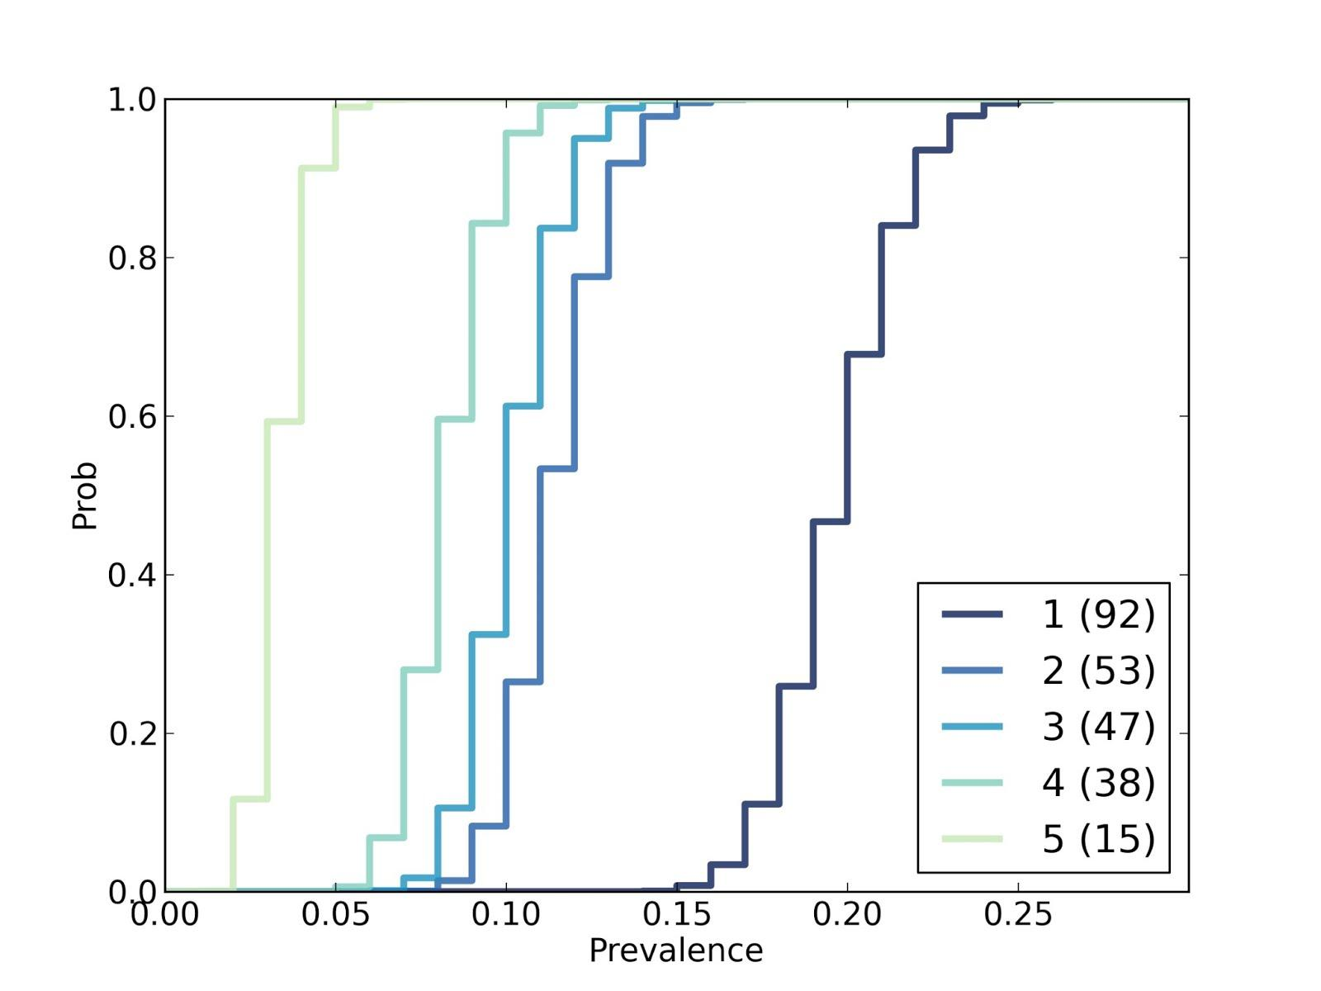
Estimated prevalences

Slide 127
What is this good for?
These distributions know everything.
If I take more samples, how many more species will I see?
How many samples do I need to reach a given coverage?

Slide 128
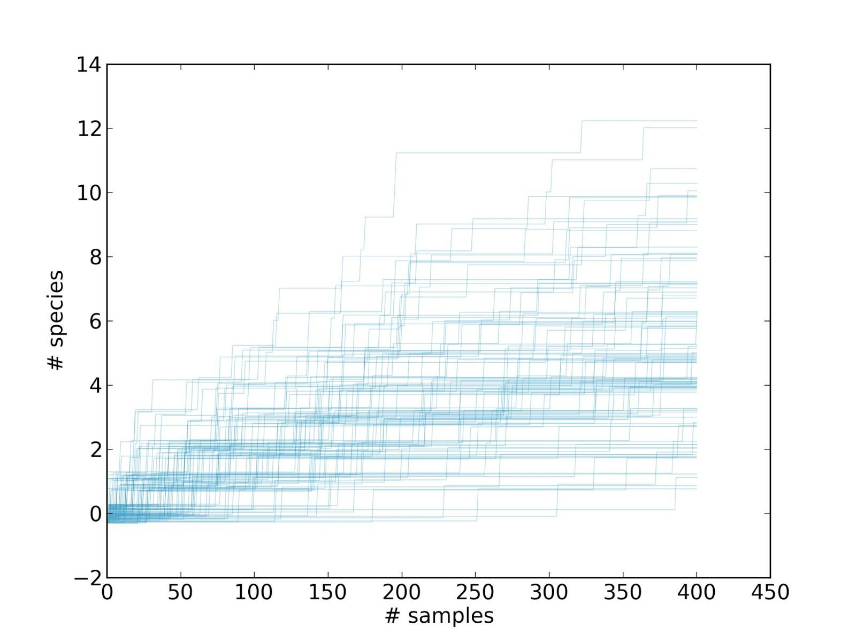
More samples, more species

Slide 129
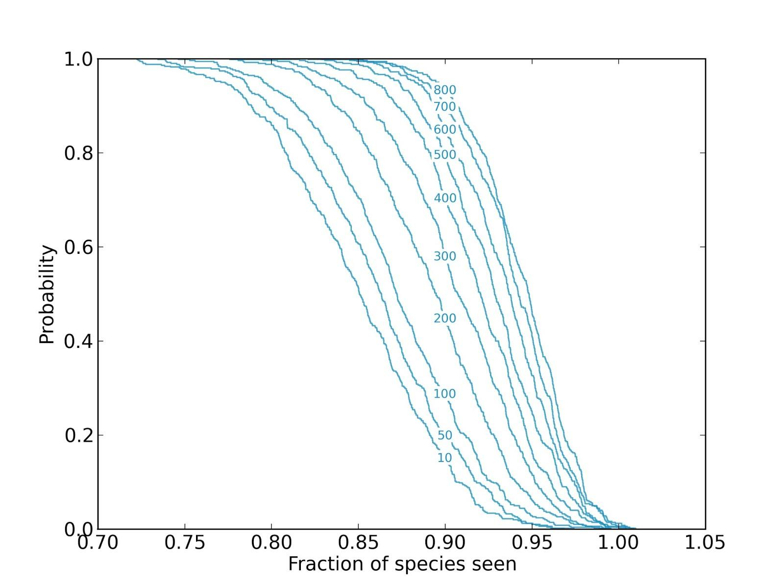
More species, more samples

Slide 130
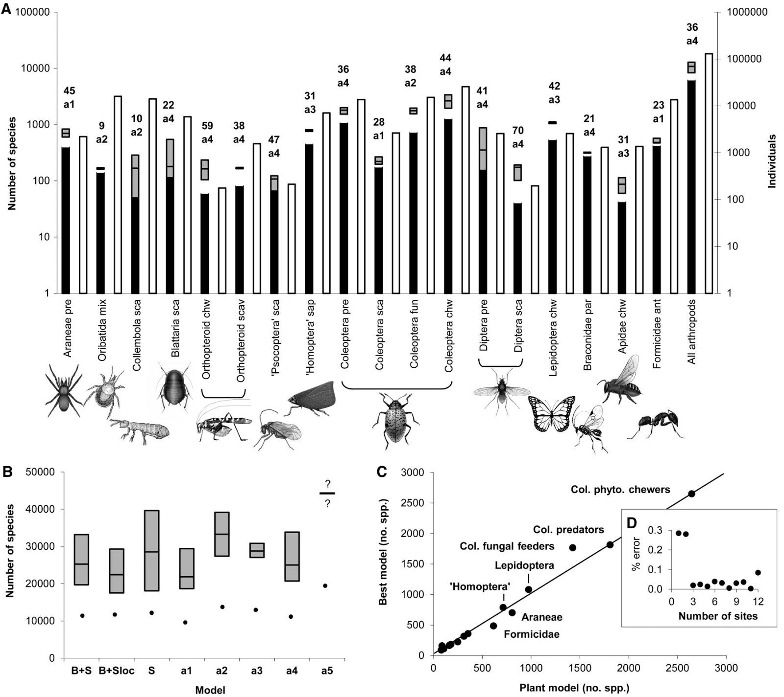
Notes:
http://www.npr.org/2012/12/14/167163274/counting-bugs-in-panama-get-out-your-tree-raft
130,000 arthropods, 6000 species

Slide 131
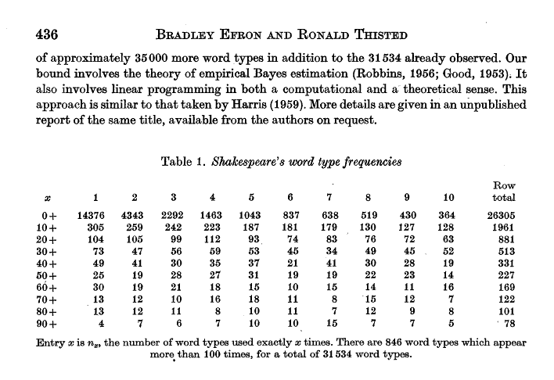
Shakespeare

Slide 132
Almost done!
https://www.surveymonkey.com/s/pycon2013_tutorials
And then some reading suggestions.

Slide 133
More reading
Think Bayes: Bayesian Statistics Made Simple
http://thinkbayes.com
It's a draft!
Corrections and suggestions welcome.

Slide 134
Case studies
Think Bayes has 12 chapters.
Euro problem
SAT problem
Unseen species problem
Hockey problem
Paintball problem
Variability hypothesis
Kidney problem

Slide 135
Case studies
My students are working on case studies:
Fire (Bayesian regression)
Collecting whale snot
Poker
Bridge
Rating the raters
Predicting train arrival times

Slide 136
Case studies
Looking for more case studies.
Motivated by a real problem.
Uses the framework.
Extends the framework?
5-10 page report.
Best reports included in the published version (pending contract).

Slide 137
Need help?
I am always looking for interesting projects.
Summer 2013.
Sabbatical 2014-15.

Slide 138


Slide 139
Remember
The Bayesian approach is a divide and conquer strategy.
You write Likelihood().
Bayes does the rest.

Slide 140
More reading
MacKay, Information Theory, Inference, and Learning Algorithms
Sivia, Data Analysis: A Bayesian Tutorial
Gelman et al, Bayesian Data Analysis

Slide 141
Where does this fit?
Usual approach:
Analytic distributions.
Math.
Multidimensional integrals.
Numerical methods (MCMC).

Slide 142
Where does this fit?
Problem:
Hard to get started.
Hard to develop solutions incrementally.
Hard to develop understanding.

Slide 143
My theory
Start with non-analytic distributions.
Use background information to choose meaningful priors.
Start with brute-force solutions.
If the results are good enough and fast enough, stop.
Otherwise, optimize (where analysis is one kind of optimization).
Use your reference implementation for regression testing.

